Slide 1
Chapter 6: CPU Scheduling
Notes:
‹#›

Slide 2
Chapter 6: CPU Scheduling
Basic Concepts
Scheduling Criteria
Scheduling Algorithms
Thread Scheduling
Multiple-Processor Scheduling
Real-Time CPU Scheduling
Operating Systems Examples
Algorithm Evaluation
Notes:
‹#›

Slide 3
Objectives
To introduce CPU scheduling, which is the basis for multiprogrammed operating systems
To describe various CPU-scheduling algorithms
To discuss evaluation criteria for selecting a CPU-scheduling algorithm for a particular system
To examine the scheduling algorithms of several operating systems

Slide 4
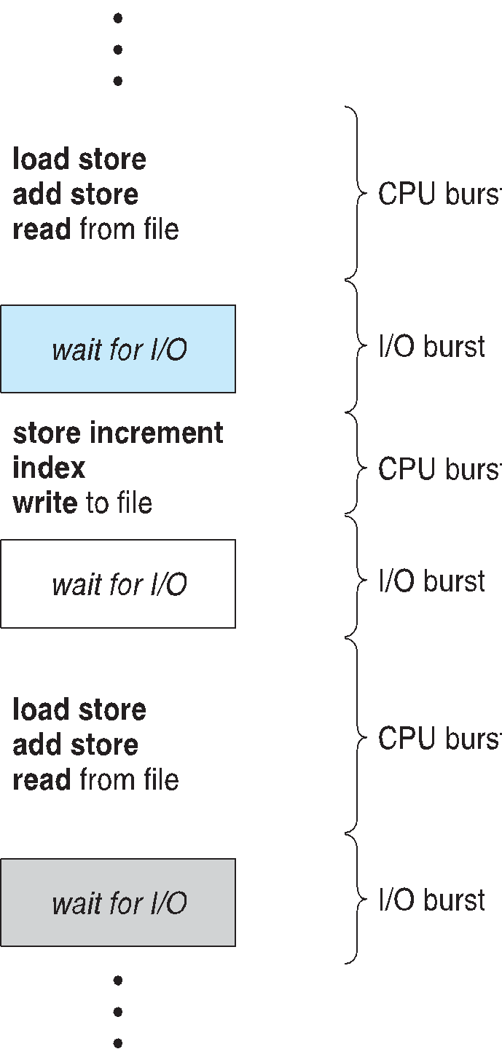
Basic Concepts
Maximum CPU utilization obtained with multiprogramming
CPU–I/O Burst Cycle – Process execution consists of a cycle of CPU execution and I/O wait
CPU burst followed by I/O burst
CPU burst distribution is of main concern
Notes:
‹#›

Slide 5
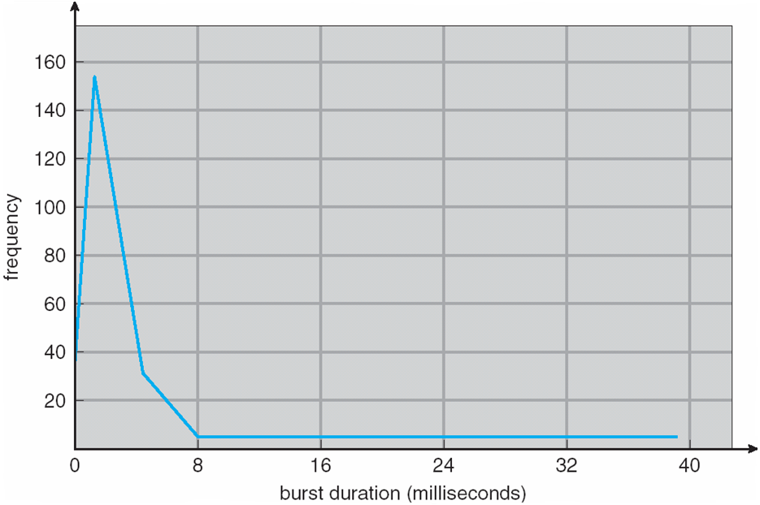
Histogram of CPU-burst Times
Notes:
‹#›

Slide 6
CPU Scheduler
Short-term scheduler selects from among the processes in ready queue, and allocates the CPU to one of them
Queue may be ordered in various ways
CPU scheduling decisions may take place when a process:
1. Switches from running to waiting state
2. Switches from running to ready state
3. Switches from waiting to ready
4. Terminates
Scheduling under 1 and 4 is nonpreemptive (no interrupt)
All other scheduling is preemptive (interrupt occurs)
Notes:
‹#›

Slide 7
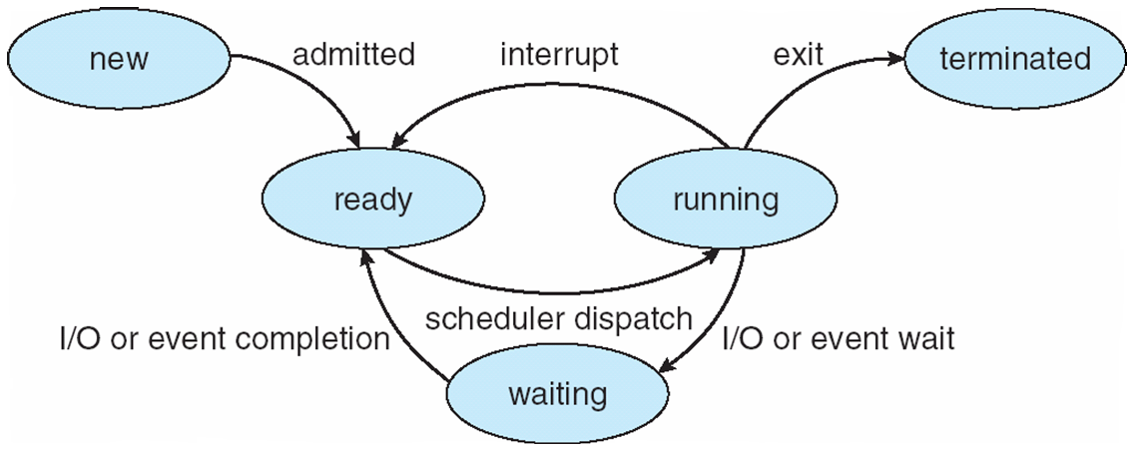
Diagram of Process State

Slide 8
Dispatcher
Dispatcher module gives control of the CPU to the process selected by the short-term scheduler; this involves:
switching context
switching to user mode
jumping to the proper location in the user program to restart that program
Dispatch latency – time it takes for the dispatcher to stop one process and start another running
Notes:
‹#›

Slide 9
Scheduling Criteria
CPU utilization – keep the CPU as busy as possible
Throughput – Number of processes that complete their execution per time unit
Turnaround time – amount of time to execute a particular process. Completion Time - Arrival Time
Waiting time – amount of time a process has been waiting in the ready queue. Turnaround Time - Burst Time
Response time – amount of time it takes from when a request was submitted until the first response is produced, not output (for time-sharing environment)
Start of Process Execution - Arrival of Process
Notes:
‹#›

Slide 10
Scheduling Algorithm Optimization Criteria
Max CPU utilization
Max throughput
Min turnaround time
Min waiting time
Min response time
Notes:
‹#›

Slide 11
First- Come, First-Served (FCFS) Scheduling
Process ID | Burst Time | Arrival Time
P1 | 24 | 0
P2 | 3 | 0
P3 | 3 | 0
The order of arrival is P₁ , P₂ , P₃ . Calculate Average Waiting Time, Turnaround Time and Average Response Time.
Note: if arrival time same and order not mentioned, consider PID as priority ( P₁ will go first among P₁ , P₂ , P₃ followed by P₂ and P₃ )
Notes:
‹#›

Slide 12
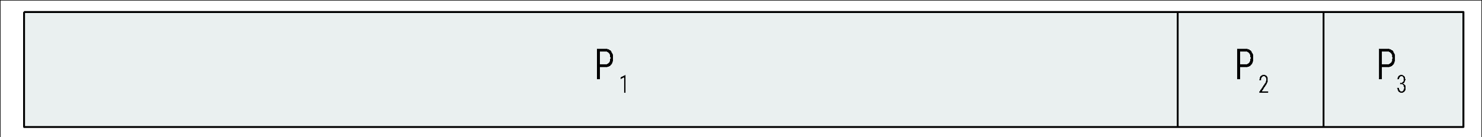
First- Come, First-Served (FCFS) Scheduling
0
24
27
30
 | Turnaround Times | Waiting Times | Response Times
P₁ | 24-0 | 24-24 | 0-0
P₂ | 27-0 | 27-3 | 24-0
P₃ | 30-0 | 30-3 | 27-0
Average | 27 | 17 | 17
Notes:
‹#›

Slide 13
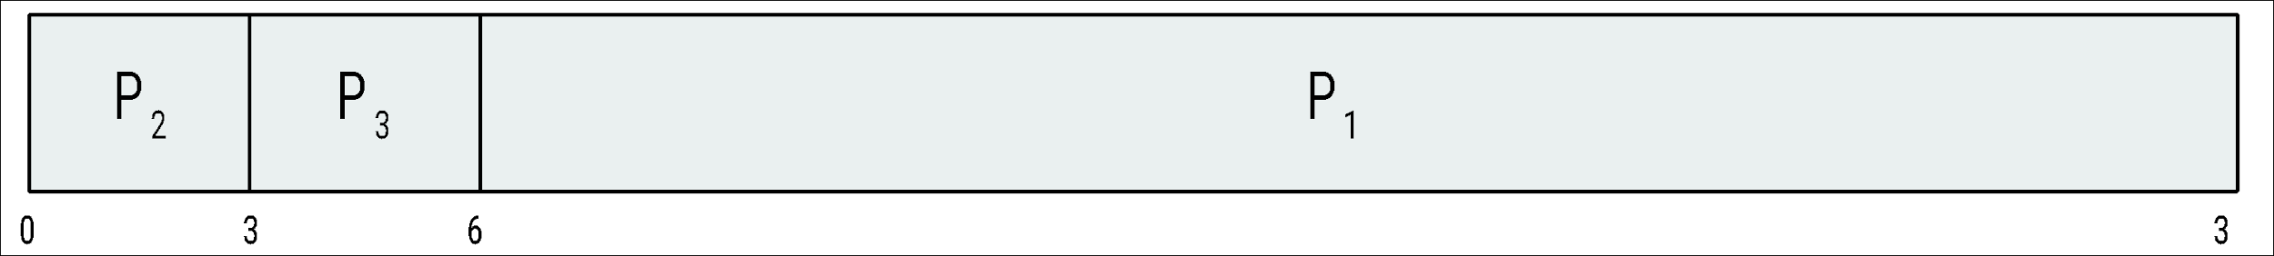
First- Come, First-Served (FCFS) Scheduling
The order of arrival is P₂ , P₃ , P1 . Calculate Average Waiting Time, Turnaround Time and Average Response Time.
30
 | Turnaround Times | Waiting Times | Response Times
P₁ | 30-0 | 30-24 | 6-0
P₂ | 3-0 | 3-3 | 0-0
P₃ | 6-0 | 6-3 | 3-0
Average | 13 | 3 | 3
Notes:
‹#›

Slide 14
FCFS Scheduling (Cont.)
Waiting Time, Turnaround Time and Response Time much better than previous case
Bad for time sharing systems: convoy effect and high wait time.
Convoy effect - short process behind long process
Consider one CPU-bound and many I/O-bound processes
Notes:
‹#›

Slide 15
FCFS Scheduling Problem
Process ID | Burst Time | Arrival Time
P1 | 5 | 4
P2 | 4 | 6
P3 | 3 | 0
P4 | 2 | 6
P5 | 4 | 5
Draw a Gantt chart of the processes. Calculate Average Waiting Time, Turnaround Time and Average Response Time.
Notes:
‹#›

Slide 16
Shortest-Job-First (SJF) Scheduling
Associate with each process the length of its next CPU burst
Use these lengths to schedule the process with the shortest time
SJF is optimal – gives minimum average waiting time for a given set of processes
Problem:
The difficulty is knowing the length of the next CPU request
Solution:
So use a probabilistic estimation
Could ask the user
Notes:
‹#›

Slide 17
Example of SJF
Process ID | Arrival | Burst Time
P1 | 0 | 8
P2 | 1 | 4
P3 | 2 | 9
P4 | 3 | 5
SJF scheduling chart
Average waiting time = (0 + 7 + 15 + 9) / 4 = 7.75
P1 | P2 | P4 | P3
0
8
12
17
26
Notes:
‹#›

Slide 18
Example of Shortest-remaining-time-first
Process ID | Arrival | Burst Time
P1 | 0 | 8
P2 | 1 | 4
P3 | 2 | 9
P4 | 3 | 5
Preemptive SJF Gantt Chart
Average waiting time = (9+0+15+2)/4 = 26/4 = 6.5
P1 | P2 | P4 | P1 | P3
0
1
5
10
17
26
Notes:
‹#›

Slide 19
Shortest-remaining-time-first Scheduling Problem
Process ID | Arrival Time | Burst Time
P1 | 0 | 10
P2 | 3 | 6
P3 | 7 | 9
P4 | 8 | 5
Draw a Gantt chart of the processes. Calculate Average Waiting Time, Turnaround Time and Average Response Time.
Notes:
‹#›

Slide 20
Priority Scheduling
A priority number (integer) is associated with each process
The CPU is allocated to the process with the highest priority (smallest integer ≡ highest priority)
Preemptive
Nonpreemptive
SJF is priority scheduling where priority is the inverse of predicted next CPU burst time
Problem ≡ Starvation – low priority processes may never execute
Solution ≡ Aging – as time progresses increase the priority of the process
Notes:
‹#›

Slide 21
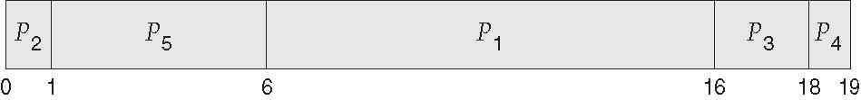
Example of Priority Scheduling
ProcessA arri Burst TimeT Priority
P₁ 10 3
P₂ 1 1
P₃ 2 4
P₄ 1 5
P₅ 5 2
Priority scheduling Gantt Chart
Average waiting time = 8.2 msec
Notes:
‹#›

Slide 22
Priority Scheduling Problem
Process ID | Burst Time | Arrival Time | Priority
P1 | 11 | 0 | 2
P2 | 28 | 5 | 0
P3 | 2 | 12 | 3
P4 | 10 | 2 | 1
P5 | 16 | 9 | 4
Draw a Gantt chart of the processes. Calculate Average Waiting Time, Turnaround Time and Average Response Time.
Notes:
‹#›

Slide 23
Round Robin (RR)
Each process gets a small unit of CPU time (time quantum q), usually 10-100 milliseconds. After this time has elapsed, the process is preempted and added to the end of the ready queue.
If there are n processes in the ready queue and the time quantum is q, then each process gets 1/n of the CPU time in chunks of at most q time units at once. No process waits more than (n-1)q time units.
Timer interrupts every quantum to schedule next process
Performance
q large ⇒ FIFO
q small ⇒ q must be large with respect to context switch, otherwise overhead is too high
Notes:
‹#›

Slide 24
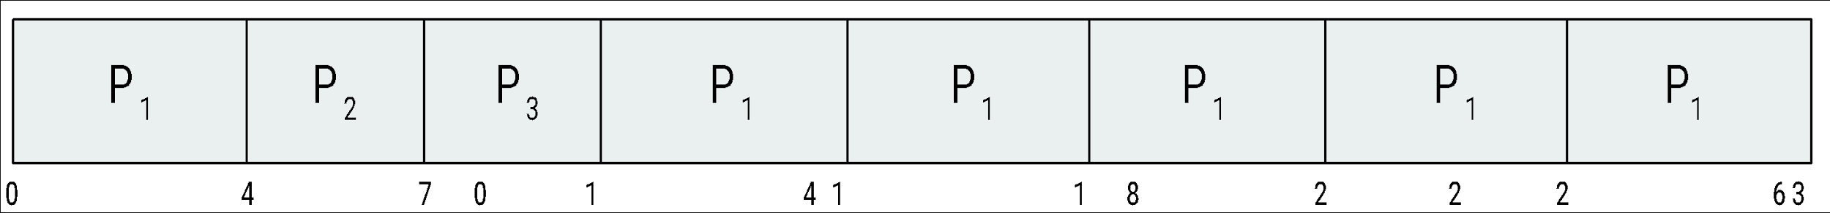
Example of RR with Time Quantum = 4
Process Burst Time
P₁ 24
P₂ 3
P₃ 3
The Gantt chart is:
Typically, higher average turnaround than SJF, but better response
q should be large compared to context switch time
Notes:
‹#›

Slide 25
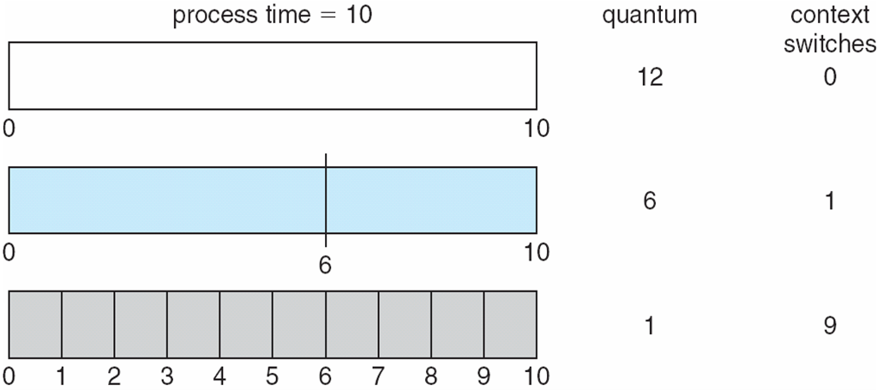
Time Quantum and Context Switch Time
Notes:
‹#›

Slide 26
Round Robin Problem (Quantum Time = 4)
Process ID | Burst Time | Arrival Time | Priority
P1 | 6 | 0 | 2
P2 | 10 | 5 | 0
P3 | 2 | 10 | 3
P4 | 12 | 2 | 1
Draw a Gantt chart of the processes. Calculate Average Waiting Time, Turnaround Time and Average Response Time.
Notes:
‹#›

Slide 27
Multilevel Queue
Ready queue is partitioned into separate queues, eg:
foreground (interactive)
background (batch)
Process permanently in a given queue
Each queue has its own scheduling algorithm:
foreground – RR
background – FCFS
Scheduling must be done between the queues:
Fixed priority scheduling; (i.e., serve all from foreground then from background). Possibility of starvation.
Time slice – each queue gets a certain amount of CPU time which it can schedule amongst its processes; i.e., 80% to foreground in RR
20% to background in FCFS
Notes:
‹#›

Slide 28
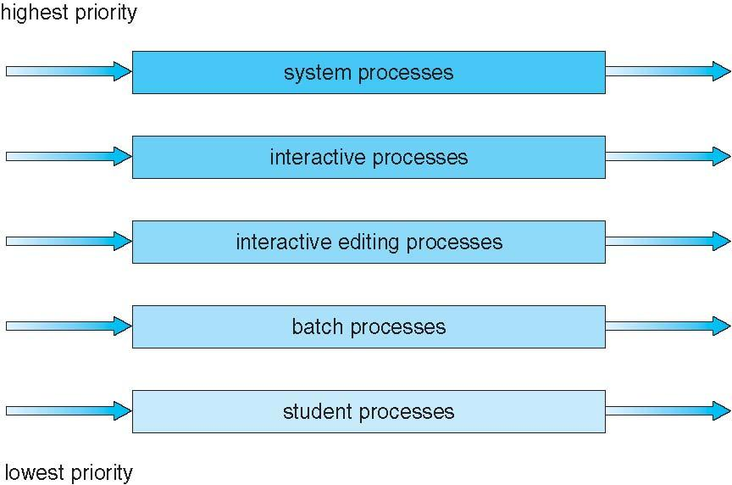
Multilevel Queue Scheduling
Notes:
‹#›

Slide 29
Multilevel Feedback Queue
A process can move between the various queues; aging can be implemented this way
Multilevel-feedback-queue scheduler defined by the following parameters:
number of queues
scheduling algorithms for each queue
method used to determine when to upgrade a process
method used to determine when to demote a process
method used to determine which queue a process will enter when that process needs service
Notes:
‹#›

Slide 30
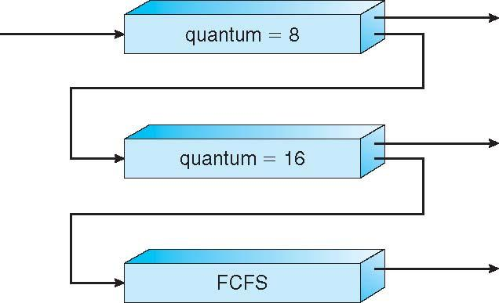
Example of Multilevel Feedback Queue
Three queues:
Q₀ – RR with time quantum 8 milliseconds
Q₁ – RR time quantum 16 milliseconds
Q₂ – FCFS
Scheduling
A new job enters queue Q₀ which is served FCFS
When it gains CPU, job receives 8 milliseconds
If it does not finish in 8 milliseconds, job is moved to queue Q₁
At Q₁ job is again served FCFS and receives 16 additional milliseconds
If it still does not complete, it is preempted and moved to queue Q₂
Notes:
‹#›

